Slide 1
TOTAL VARIATION WITH L2-L1 FOR DENSE OPTICAL FIELD COMPUTATION
Thesis presentation

Slide 2
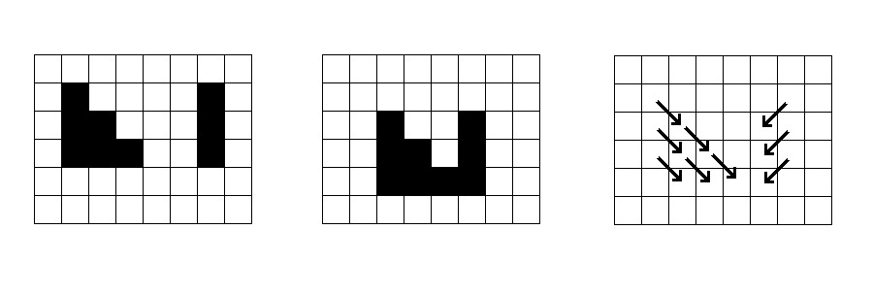
What is optical flow

Slide 3
Applications of optical flow

Slide 4
Motivation

Slide 5
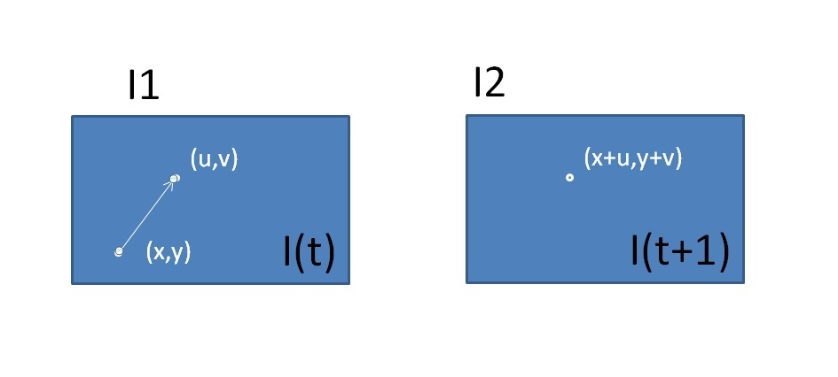

Brightness assumption

Slide 6
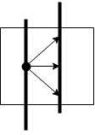

Aperture problem
Solve
$$I\left(x,y\right)=I(x+u,y+v)$$
u and v.

Slide 7
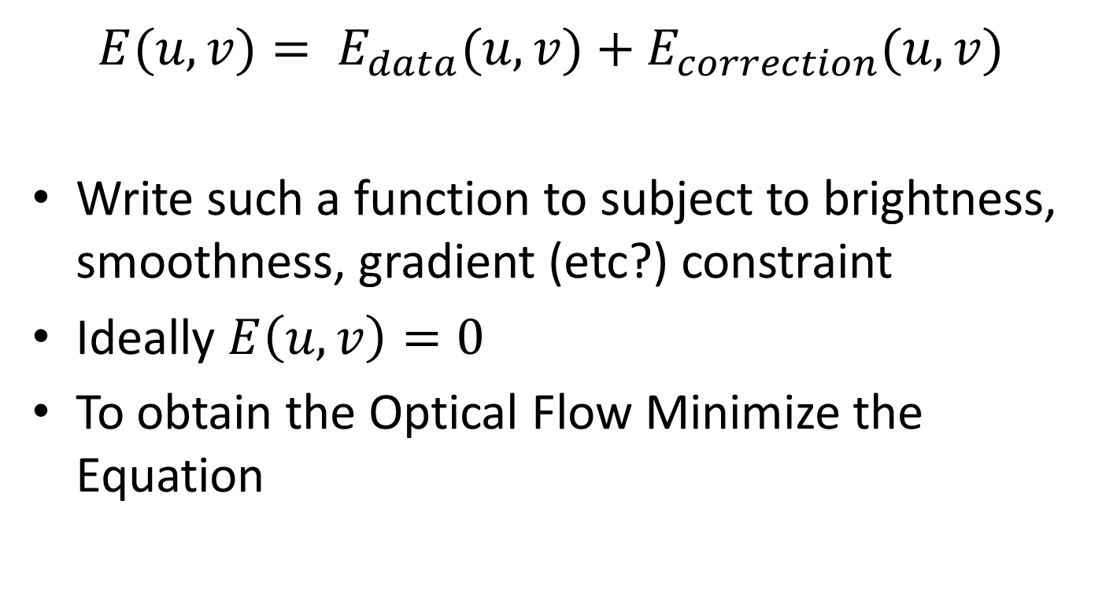
Formulation of the Energy Function
$$E(u,v)= E_{data}(u,v)+E_{correction}(u,v)$$
Write such a function to subject to brightness, smoothness, gradient (etc?) constraint
Ideally $E\left(u,v\right)=0$
To obtain the Optical Flow Minimize the Equation

Slide 8
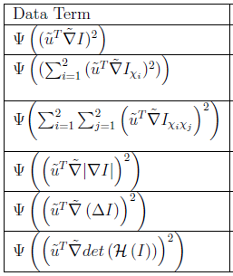
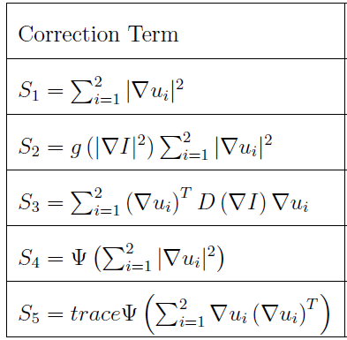
Formulations of the Energy function Examples

Slide 9
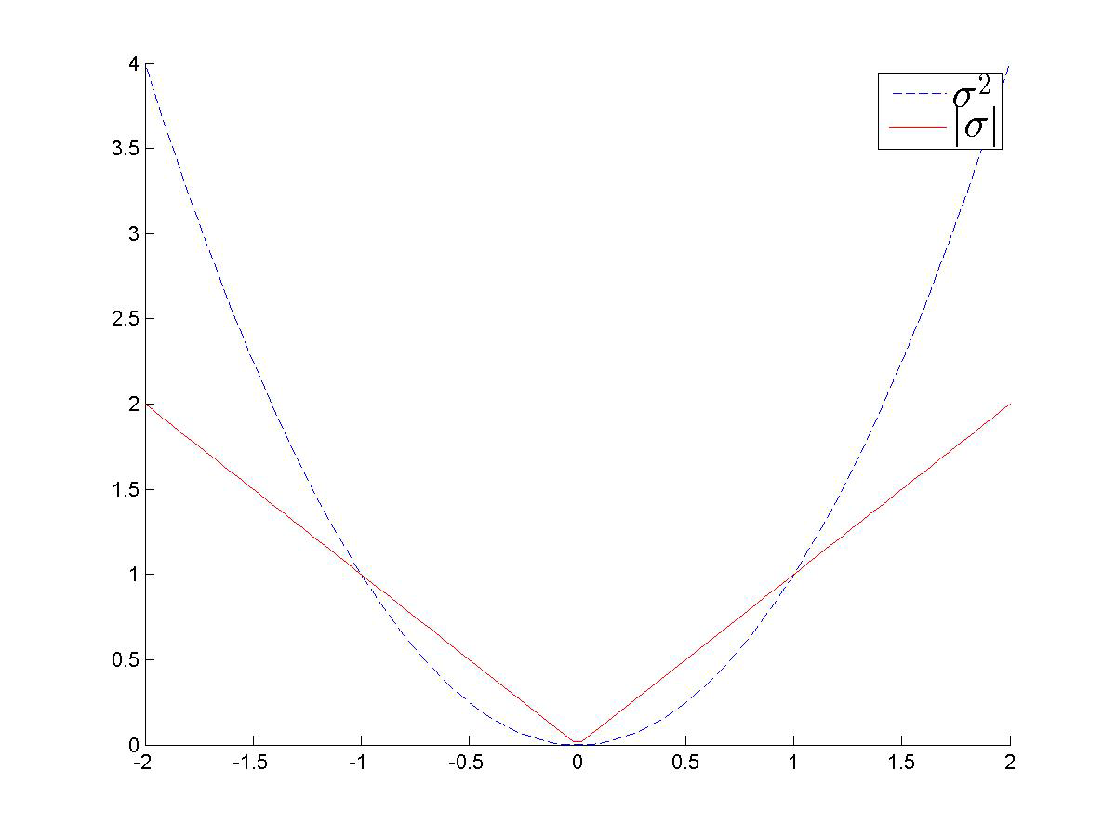
Energy Function L2 vs. L1

Slide 10
Energy Function L2 vs. L1
Advantages
Fast
Straight Forward
Disadvantages
Low Robustness
Advantages
More complex
Disadvantages
Robust
NonIsotropic

Slide 11
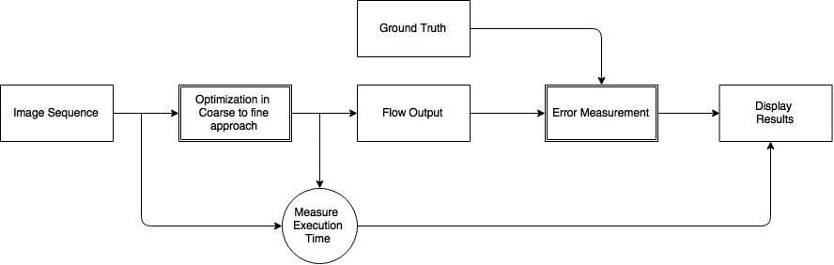
System Overview

Slide 12
Coarse-to-fine approach
Based on Gaussian or Lagrange Pyramids
Detects large displacements
??

Slide 13
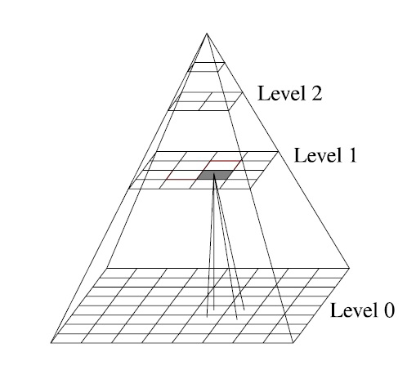
Coarse-to-fine approach

